Slide 1
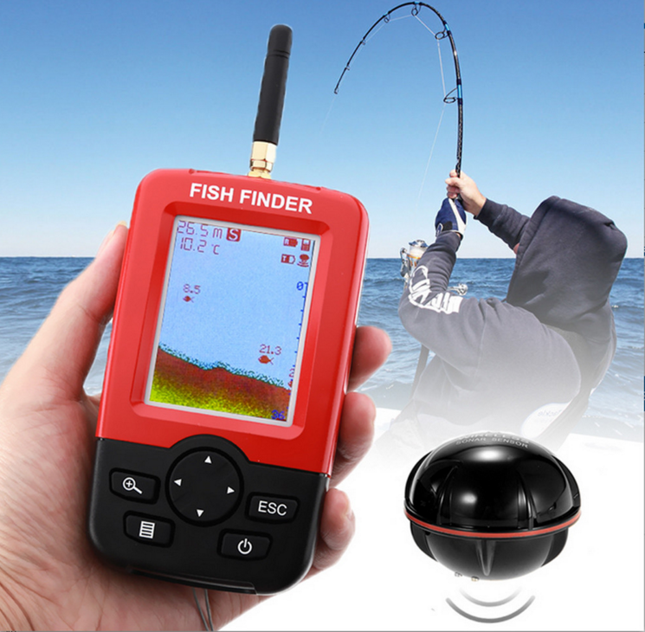
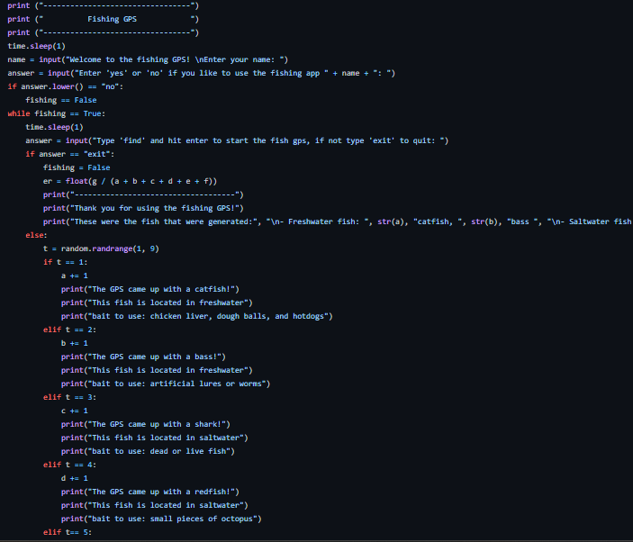
Fisherman’s heaven
Peyton Whitener
This fishing GPS generates the location and bait of the fish a person desires to catch
https://github.com/ksu-is/Fishermans-heaven/blob/main/fishermans.py

